Slide 1

GLOBAL INSTITUTE OF TECHNOLOGY
Department of
Computer Science & Engineering
Subject Name with code: Data Structure & Algorithms
Unit-3
Presented by: Mr. Sohan Lal Gupta
Assistant Professor, CSE

Slide 2
GLOBAL INSTITUTE OF TECHNOLOGY JAIPUR
Data Structure & Algorithms
CSE/ III Sem
Lecture No. 1
Sohan Gupta

Slide 3
3.1. Searching Techniques:
GLOBAL INSTITUTE OF TECHNOLOGY JAIPUR
Data Structure & Algorithms
CSE/ III Sem
It is the algorithmic process of finding a particular item in a collection of items
Searching is the process of finding a given value position in a list of values
It decides whether a search key is present in the data or not.
It can be done on internal data structure or on external data structure.
Sohan Gupta

Slide 4
3.2 Types of Searching
GLOBAL INSTITUTE OF TECHNOLOGY JAIPUR
Data Structure & Algorithms
CSE/ III Sem
It can be done in following ways:
1. Sequential Search
2. Binary Search
Sohan Gupta

Slide 5
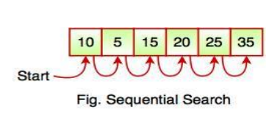
GLOBAL INSTITUTE OF TECHNOLOGY JAIPUR
Data Structure & Algorithms
CSE/ III Sem
3.2.1. Sequential Search
Sequential search is also called as Linear Search.
Sequential search starts at the beginning of the list and checks every element of the list.
It is a basic and simple search algorithm.
Sequential search compares the element with all the other elements given in the list. If the element is matched, it returns the value index, else it returns - 1.
Sohan Gupta

Slide 6
GLOBAL INSTITUTE OF TECHNOLOGY JAIPUR
Data Structure & Algorithms
CSE/ III Sem
The following code snippet shows the sequential search operation:
function searchValue(value, target)
{
for (var i = 0; i < value.length; i++)
{ if (value[i] == target)
{
return i;
}
}
return -1;
}
Sohan Gupta

Slide 7

GLOBAL INSTITUTE OF TECHNOLOGY JAIPUR
Data Structure & Algorithms
CSE/ III Sem
3.2.2. Binary Search
Binary Search is used for searching an element in a sorted array
It is a fast search algorithm with run-time complexity of O(log n)
Binary search works on the principle of divide and conquer
This searching technique looks for a particular element by comparing the middle most element of the collection.
It is useful when there are large number of elements in an array.
First, we shall determine half of the array by using this formula − mid = low + (high - low) / 2
Sohan Gupta

Slide 8
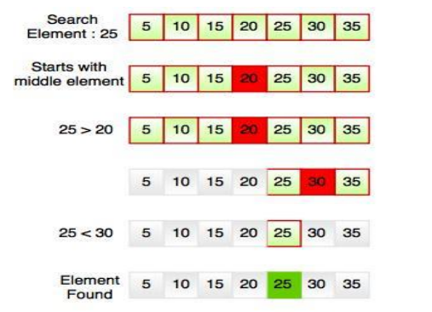
GLOBAL INSTITUTE OF TECHNOLOGY JAIPUR
Data Structure & Algorithms
CSE/ III Sem
Example
For example, if searching an element 25 in the 7-element array, following figure shows how binary search works:
Sohan Gupta

Slide 9
GLOBAL INSTITUTE OF TECHNOLGY JAIPUR
Data Structure & Algorithms
CSE/ III Sem
Thank You… .
Any Quries ?
Sohan Gupta

